Slide 1
Development of master curricula for natural disasters risk management in Western Balkan countries
Financial plan and supporting documents
Milan Gocić
University of Niš
First Steering Committee meeting/ 05th April 2017
Project number: 573806-EPP-1-2016-1-RS-EPPKA2-CBHE-JP
"This project has been funded with support from the European Commission. This publication reflects the views only of the author, and the Commission cannot be held responsible for any use which may be made of the information contained therein"

Slide 2
NatRisk budget info
Development of master curricula for natural disasters risk management in Western Balkan countries
The grant shall be of a maximum of EUR 1,245,746.00 and shall take the form of:
Staff costs: 350,700 EUR
Travel costs: 80,510 EUR
Costs of stay 181,275 EUR
Equipment costs: 264,800 EUR
Subcontracting: 48,000 EUR
Special Mobility Strand: 320,461 EUR
Total project expenditures: 1,245,746 EUR

Slide 3
Installments from EACEA to the Project coordinator
Development of master curricula for natural disasters risk management in Western Balkan countries
pre-financing payment of 50% of the maximum amount upon entry into force of the Agreement
second payment of 40% of the maximum amount if:
at least 70% of the previous pre-financing installment is spent
the statement of costs incurred and the request for payment is sent to EACEA
the progress report on the implementation of the Action (Intermediate report) is sent to EACEA
balance of 10% upon the approval of the Final Report

Slide 4
Exchange rate
Development of master curricula for natural disasters risk management in Western Balkan countries
Exchange rate which we will used :
On the month of the first pre-financing for all costs incurred until the second pre-financing is received
On the month of the second pre-financing for all costs incurred until the end of the project
Exchange rates for November 2016 are:
Serbia: 1 EUR = 123.1973 RSD
UK: 1 EUR = 0.89905 GBP
Bosnia and Herzegovina: 1 EUR = 1.95583 BAM
Hungary: 1 EUR = 309.46 HUF

Slide 5
Staff Costs
Development of master curricula for natural disasters risk management in Western Balkan countries
Budget Line Staff Costs has four categories:
Manager (legislators, senior officials and managers)
Researcher,teacher and trainer, (typically carry out academic activities related to curriculum/training programme development, development and adaptation of teaching/training materials, preparation and teaching of courses or trainings)
Technical staff (technicians and associate professionals)
Adminastrative staff (office and customer service clerks)
One working day defined according to applicable national legislation
Declared working days per individual should not exceed 20 days per month or 240 days per year

Slide 6
Staff Costs - Supporting documents
Development of master curricula for natural disasters risk management in Western Balkan countries
To keep with project accounts (requested in case of financial check):
JOINT DECLARATION(ANNEX II) for each person employed ORIGINAL (http://www.natrisk.ni.ac.rs/activities?id=27 Annex O-1)
TIME-SHEETS (attached to each staff convention), indicating number of days worked for corresponding month/year, description of tasks , outputs produced and related work package ORIGINAL (http://www.natrisk.ni.ac.rs/activities?id=27 Annex O-3)
ANY EVIDENCE allowing to verify that declared workloads correspond to actual activities/outputs (e.g. attendance lists for lectures given, tangible outputs / products, salary slips, etc.) Certified copy
EMPLOYMENT CONTRACT Certified copy
PROOF OF PAYMENT (net + taxes) Certified copy
TAX STATEMENT (if applicable by national law) Certified copy

Slide 7
Staff Costs
Development of master curricula for natural disasters risk management in Western Balkan countries
Staff Convention Form
signed by task performer,
signed and stamped by the person responsible (e.g. Rector, Vice-rector)
For different staff categories, separate convention forms
Time sheet
indicating date of the service provided
indicating number of days worked
indicating the task performed
signed by task performer and by the responsible person
Fill timesheets according to your project activities and Financial plan without RGU (Staff-1 for the first project year) that can be found on NatRisk platform.

Slide 8
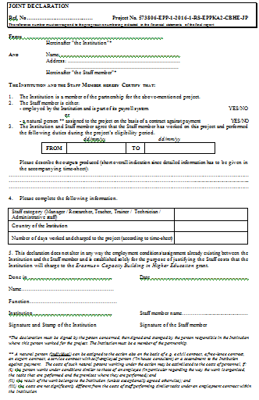
Development of master curricula for natural disasters risk management in Western Balkan countries
P9 – SC – 001
Example 1
573806-EPP-1-2016-1-RS-EPPKA2-CBHE-JP
All documents to be delivered in three hard copies and certified (true copy of the primary do cument)
All these documents which regarding the Staff costs, Travel costs etc, should be scanned and posted on the project platform in the area that provided for this purpose. http://mngt.natrisk.ni.ac.rs/

Slide 9
Travel costs and Costs of stay
Development of master curricula for natural disasters risk management in Western Balkan countries
Travel costs
The travel distance identified will be used to calculate the corresponding unit cost (http://ec.europa.eu/programmes/erasmus-plus/tools/distance_en.htm). Each unit cost applied will contribute to the costs of travel for the round trip, regardless of the expenses actually incurred.
Costs of stay
In order to apply the correct unit cost, the beneficiary must identify the duration in days of the activity (including the travel from their place of origin to the venue of the activity and vice-versa) and apply the corresponding unit costs.
Each unit cost applied will contribute to the costs of stay regardless of the expenses actually incurred.

Slide 10
Travel costs and Costs of stay - Supporting documents
Development of master curricula for natural disasters risk management in Western Balkan countries
Individual travel report (ITR) - SIGNED & filled – ORIGINAL (http://www.natrisk.ni.ac.rs/activities?id=27 Annex O-2)
Table of specificaltion of travel and stay costs Certified copy
Travel order/decision (if applicable) Certified copy
Proof that the trip actually took place (e.g. travel tickets, boarding passes, invoices, receipts, proof of attendance in meetings and/or events (attendance list), agendas, tangible outputs/products, minutes of meetings) Certified copy
Proof of payment for travel costs (bank statement) Certified copy
Proof of payment for stay cost (bank statement) Certified copy
Proof of payment for taxes (if any) Certified copy

Slide 11
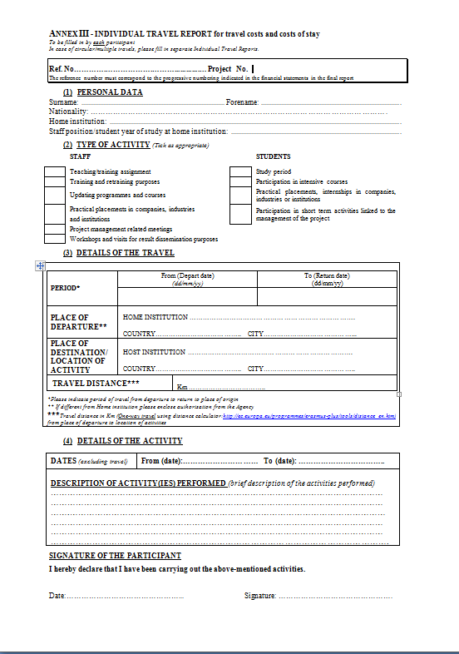
Development of master curricula for natural disasters risk management in Western Balkan countries
P9 – ITR– 001
Example 2
573806-EPP-1-2016-1-RS-EPPKA2-CBHE-JP
All documents to be delivered in three hard copies and certified (true copy of the primary document)
Short description

Slide 12
Equipment - Supporting documents
Development of master curricula for natural disasters risk management in Western Balkan countries
For the purposes of any financial evaluation and/or audit, beneficiaries will have to be able to justify / prove the following elements:
The declared costs are identifiable and verifiable, in particular being recorded in the accounting system of the Beneficiary.
The equipment is properly registered in the inventory of the institution concerned. NOTICE: All equipment must be Labelled with E+ stickers
The following should be retained with the project accounts: Invoice(s) for all purchased equipment (please note that order forms, pro-forma invoices, quotations or estimates are not considered as proof of expenditure). Certified copy
VAT exemption statement Certified copy
Documentation on the tendering procedure and three quotations (for more than 25000 Euros) Certified copy
Proof of payment (bank statement) Certified copy
Not foreseen in the application/budget? Prior written - >authorisation from Agency

Slide 13
Subcontrating - Supporting documents
Development of master curricula for natural disasters risk management in Western Balkan countries
Typical activities which may be sub-contracted (provided they are not carried out by beneficiaries' staff):
Evaluation activities and auditing
IT courses
Language courses
Printing, publishing and dissemination activities
Translation services
Web design and maintenance
Invoices, subcontracts and bank statements Certified copy
Not foreseen in the application/budget? Prior written -> authorisation from Agency

Slide 14
Partners’ report
Development of master curricula for natural disasters risk management in Western Balkan countries
Technical report
Reporting on the progress of project activities realized at the partner institution
Includes progress indicators
Financial report (Excel table)
Declaring the amount of grant spent in the reporting period
Supporting documents for all declared costs (hard copies = some original documents + certified copy)

Slide 15
Documentation
Development of master curricula for natural disasters risk management in Western Balkan countries
All financial documentation should be prepared in three hard copies for UNI + one or more copies for your HEI and sent by post at
For NatRisk
Milan Gocic
University of Nis
Univerzitetski trg 2
18000 Nis
SERBIA
Financial documentation (staff costs, travel costs, equipment and subcontracting costs) should be scanned as pdf and uploaded on NatRisk platform under your HEI acronym and sent at natriskuni@gmail.com.

Slide 16
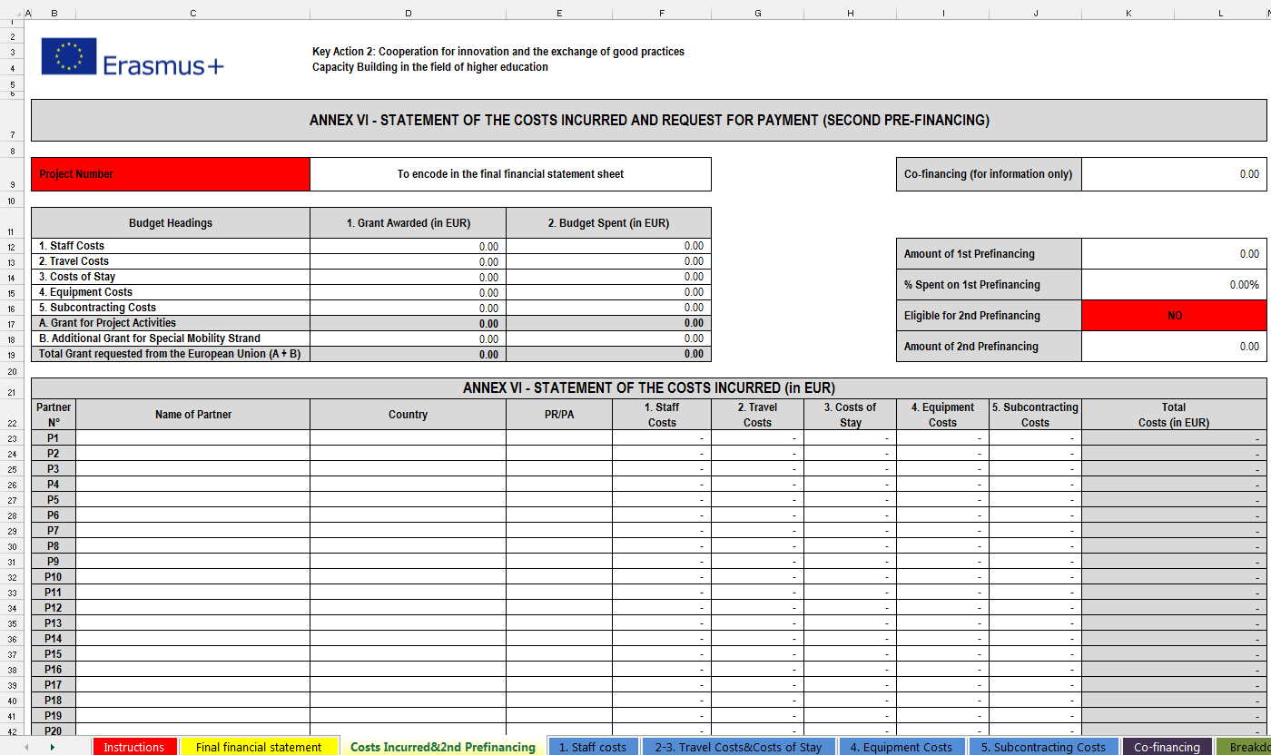
Financial reporting
Development of master curricula for natural disasters risk management in Western Balkan countries
Instructions
Final financial statement
Costs incurred&2nd Prefinancing
1. Staff costs
2-3. Travel Costs&Costs of Stay
4. Equipment Costs
5. Subcontracting Costs
Co-financing
Breakdown and Project Funding
Breakdown Staff and Travel Costs

Slide 17
Development of master curricula for natural disasters risk management in Western Balkan countries

Slide 18
Penalties
Development of master curricula for natural disasters risk management in Western Balkan countries
Grant Agreement defining the penalties for poor, partial or late implementation of project activities (Article I.10.6, II.17) and visibility obligations (Articles I.10.9 and I.10.10) with the purpose of sound financial management and to avoid any possible risks.

Slide 19
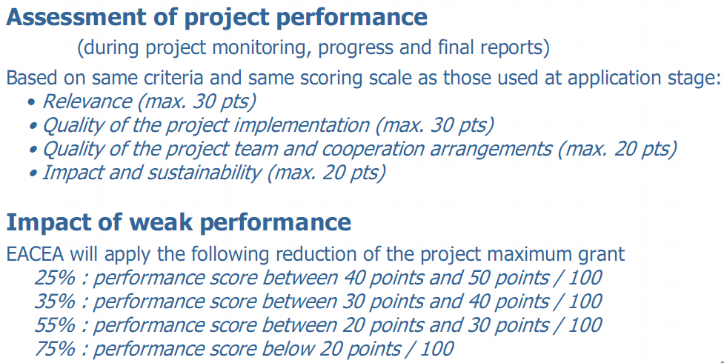
Penalties for weak implementation
Development of master curricula for natural disasters risk management in Western Balkan countries

Slide 20
Articles I.10.10 Penalties in the case of non-compliance with publicity obligations
Development of master curricula for natural disasters risk management in Western Balkan countries
The obligation to comply with the publicity provisions set out in Article II.7 of the General Conditions constitutes a substantial obligation. Without prejudice to the right to terminate the grant, in case of failure to fulfil this obligation, the Agency may apply a 20% reduction of the grant initially provided for.

Slide 21
Articles I.10.10 Administrative and financial penalties
Development of master curricula for natural disasters risk management in Western Balkan countries
Beneficiary which has committed substantial errors, irregularities or fraud, has made false declarations in supplying required information or has failed to supply such information at the moment of the submission of the application or during the implementation of the grant,or has been found in serious breach of its obligations under the Agreement shall be liable to:
a) administrative penalties consisting of exclusion from all contracts and grants financed by Union budget for a maximum of five years from the date on which the infringement is established and confirmed following a contradictory procedure with the beneficiary

Slide 22
Articles I.10.10 Administrative and financial penalties
Development of master curricula for natural disasters risk management in Western Balkan countries
b) financial penalties of 2% to 10% of the value of the contribution the beneficiary concerned is entitled to in accordance with the estimated budget set out in Annex III.
In the event of another infringement within five years following the establishment of the first infringement, the period of exclusion under point a) may be extended to 10 years and the range of the rate reffered to in point b) may be increased to 4% to 20%.

Slide 23
Articles I.10.10 Administrative and financial penalties
b) financial penalties of 2% to 10% of the value of the contribution the beneficiary concerned is entitled to in accordance with the estimated budget set out in Annex III.
In the event of another infringement within five years following the establishment of the first infringement, the period of exclusion under point a) may be extended to 10 years and the range of the rate reffered to in point b) may be increased to 4% to 20%.

